Slide 1
REAL WORLD CHALLENGES OF IMPLEMENTING INFORMATION SYSTEMS IN FINANCIAL INSTITUTION: THE PERSPECTIVE OF BANGLADESH DEVELOPMENT BANK LIMITED (BDBL)

Slide 2
Prepared for
Dr.Mohammed Shafiul Alam Khan
Associate Professor
Institute of Information Technology
Prepared by
Group 3
Members:
Tulshi Chandra Das (811)
Afia Sajeeda (832)
Saara Sheneen (833)
Maloy Kanti Sarker (834)

Slide 3

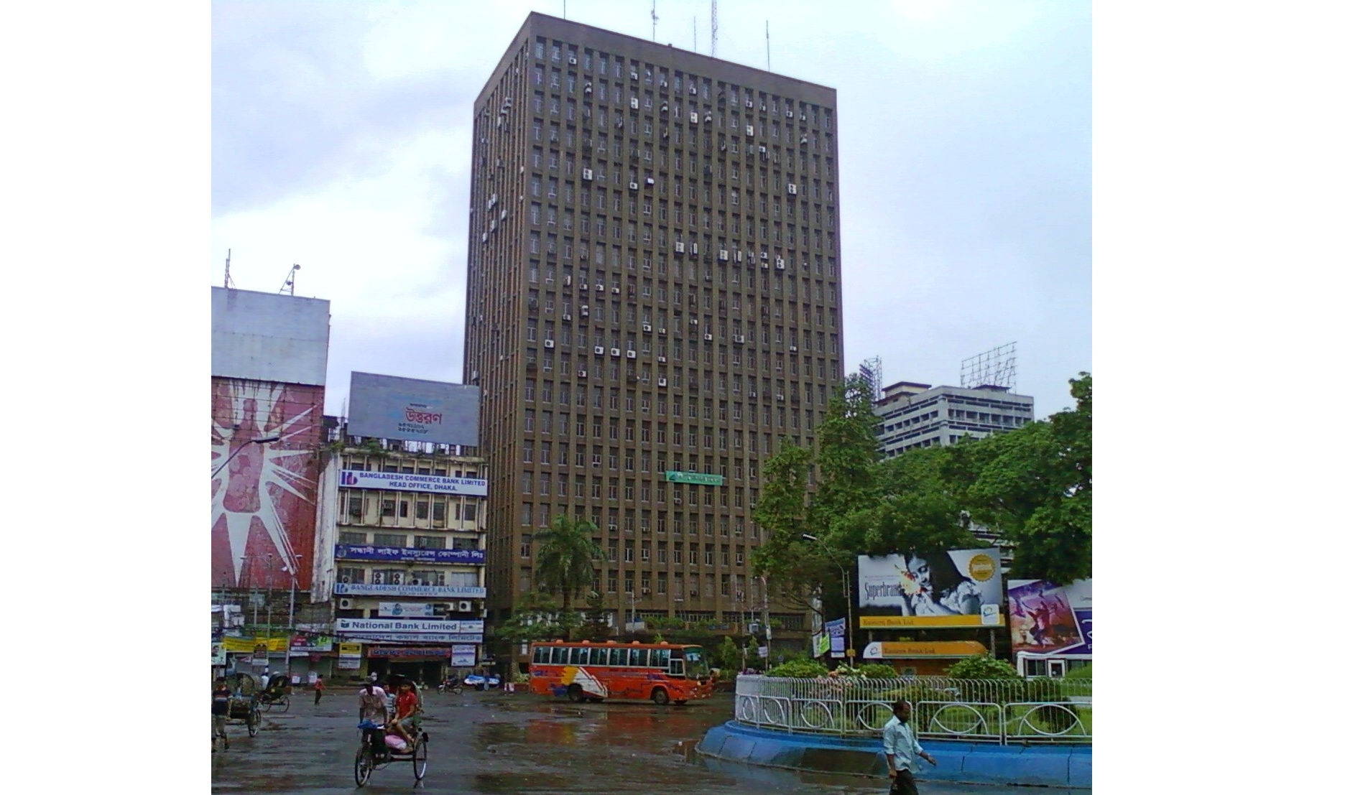

Slide 4
Challenges of Implementing Information System

Slide 5
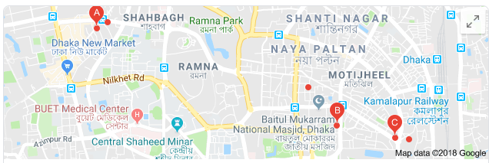
Single connection between head offices and branches
At least two connections are required

Slide 6
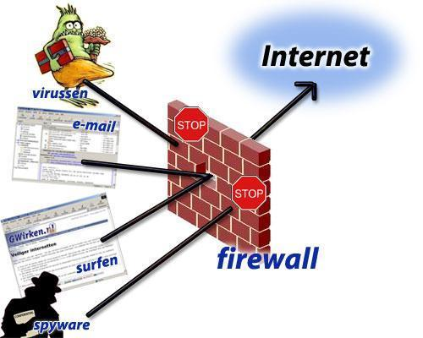
No Firewall Protection
Currently under construction but progress is slow

Slide 7

Poor condition of Data Center because of depending on manual procedures
Plan of purchasing SAN

Slide 8


Lack of Manpower. Recruitment Process of State-Run Organization is too long and complicated
Plans of recruiting more…

Slide 9
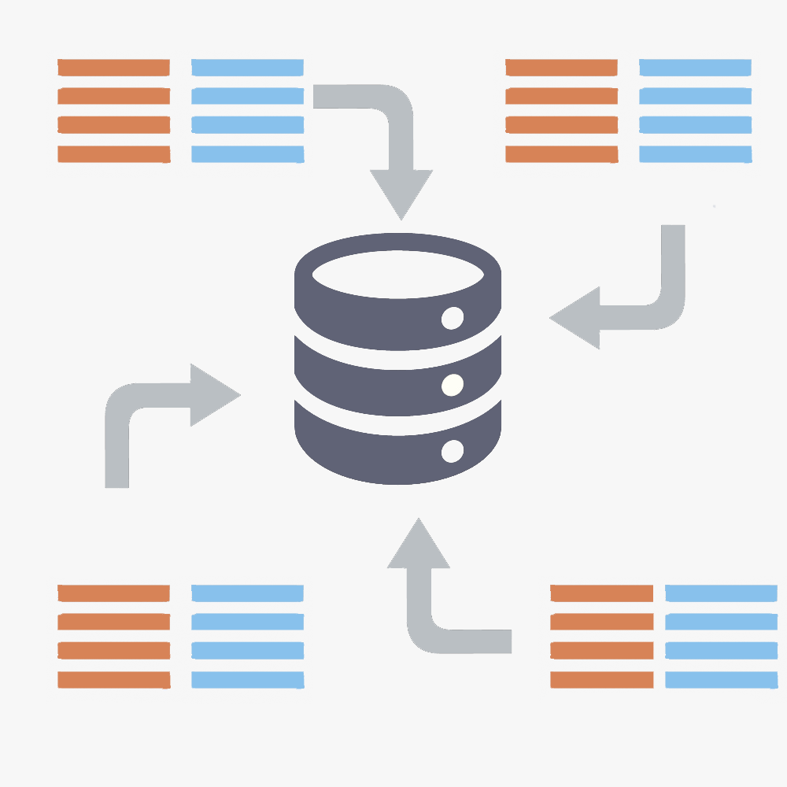
One data center with incomplete data
In Karwan Bazar. No more backups
Construction of data center in Jessore which is assumed to be less earthquake-prone zone

Slide 10
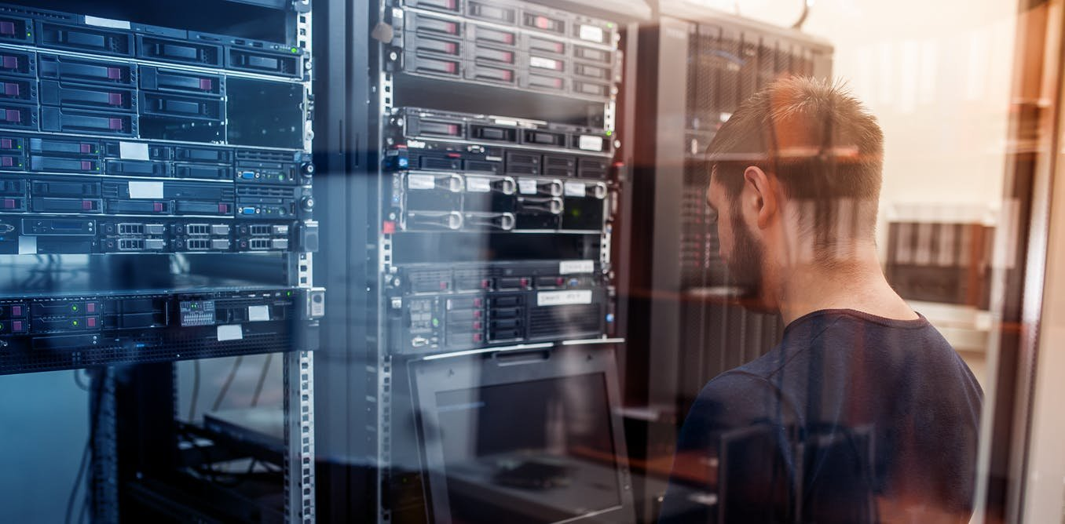
Database and Network Administrator has a Business Background
Ideas situations demand an administrator without business knowledge to avoid fraudulence

Slide 11
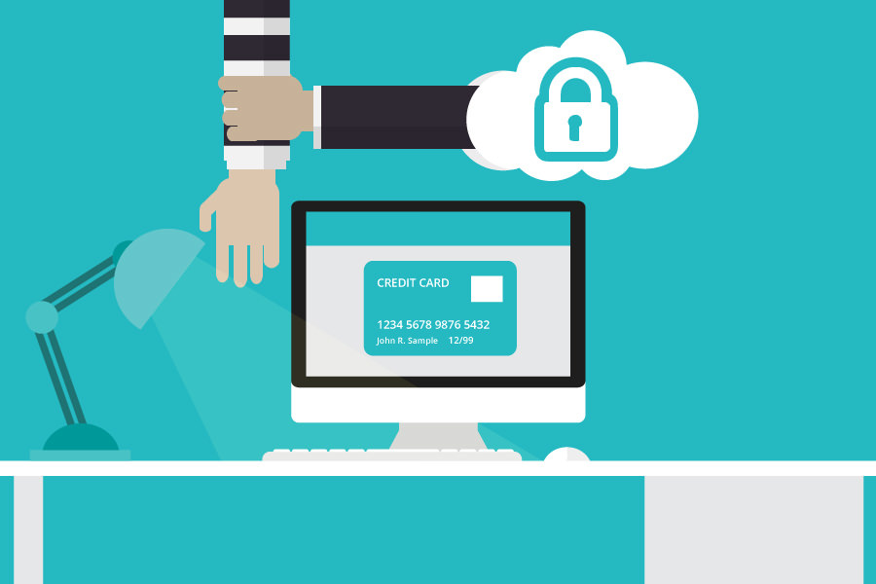
No Separate Data Security Team
Has Recruitment Plans…

Slide 12

No Independent Audit Team
Has Recruitment Plans…

Slide 13

No Maintenance Team
Has Recruitment Plans…

Slide 14
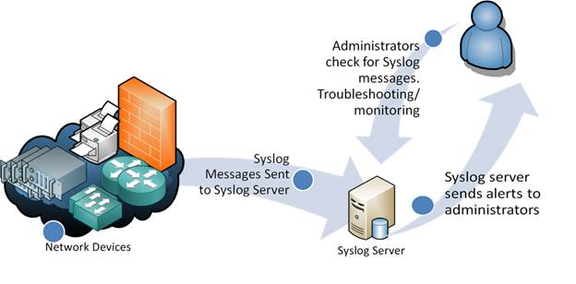
No Syslog Servers
No plans mentioned

Slide 15
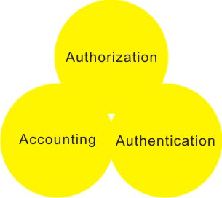
No AAA Servers
No plans mentioned

Slide 16
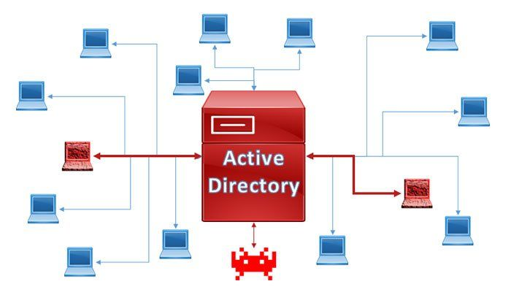
No Existence of Active Directory. Any authorized user has access to sensitive data because of this.
Plans of Purchasing

Slide 17
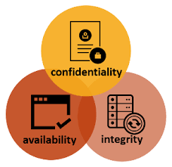
System Vulnerability
Construction of Firewall

Slide 18

Display to Monitor Branch Activities
Plans of Building

Slide 19

Absence of Mobile Banking
No plan yet

Slide 20

Online Load Application Submission System
Under construction

Slide 21
e-library
Almost completed.
Open for employees
e-Attendance
Development is in its final stage
Video Conferencing
Skype and other applications
Has plans of developing own information system

Slide 22
Recommendations

Slide 23
1. Establishment of Firewall
2. Purchasing syslog Server
3. Training Staff

Slide 24
4. Purchase of Active Directory as soon as possible
5. Purchasing SAN Server
6. Launch Mobile Services

Slide 25
Recommendations
A system that would help selecting loan
applicants by identifying projects which have
the potential of significant economic growth

Slide 26
Thank You!
Any questions?

